Slide 1
CSCI 544
Deep Learning for NLP:
Lecture 1
http://sami.haija.org/cs544/DL1

Slide 2
Agenda
What is Machine Learning
What is TensorFlow
TensorFlow Document Classification

Slide 3
Agenda
What is Machine Learning [quick recap]
What is TensorFlow [Framework + Examples]
TensorFlow for Document Classification [Demonstration]

Slide 4
Agenda
What is Machine Learning [quick recap]
Major Components of ML programs.
Summary of “Deep Learning”.
Computer Vision example.
What is TensorFlow [Framework + Examples]
TensorFlow for Document Classification [Demonstration]

Slide 5
Agenda
What is Machine Learning [quick recap]
Major Components of ML programs.
Summary of “Deep Learning”.
Computer Vision example.
What is TensorFlow [Framework + Examples]
Basics & Toy Programs
TensorFlow for Document Classification [Demonstration]

Slide 6
Agenda
What is Machine Learning [quick recap]
Major Components of ML programs.
Summary of “Deep Learning”.
Computer Vision example.
What is TensorFlow [Framework + Examples]
Basics & Toy Programs
TensorFlow for Document Classification [Demonstration]
Code walk-through and explanation.

Slide 7
Who am I ?
First Year PhD student. My advisors are Aram Galstyan and Greg V. Steeg.
Born and raised in Jordan. Also lived in Canada [and USA].
Arabic is my first language !
Before USC, I spent 4 years at Google AI, doing research in Computer Vision and Graph theory, where I:
published papers: NIPS, CVPR, KDD, CIKM.
helped with Computer Vision code went into YouTube and Google Photos.
interviewed ~300 candidates for Google and Google AI.
My current research interests are: Graph Theory, Learning Theory and Information Theory.
I am relatively new to NLP !
Very excited and honored to be teaching you about Deep Learning and how to apply it !

Slide 8
Primary Goals: Why Deep Learning and TensorFlow?
Some of the most useful technical skills to learn in school.
Useful for Research. You can minimize coding time by 10-fold and focus your energy on the application
Useful for the job market. If you learn this well, you will guarantee 6-digit salary (and people will fight over you)
Easy access to state-of-the-art techniques:
Optimization Algorithms (SGD, Adam, …)
Layers (Dense, Convolution, BatchNorm, Dropout)
Initialization
Even though NLP will be our main application, the skills learned are useful across other applications.

Slide 9
Agenda
What is Machine Learning
What is TensorFlow
TensorFlow Document Classification

Slide 10
What is Machine Learning (ML)?
It is a subfield of Artificial Intelligence where Algorithms are automatically learned from data.
Deep Learning
AI
ML

Slide 11
What is Machine Learning (ML)?
It is a fast growing field in Computer Science
Many more Jobs than qualified candidates.
Pays good money!!!
Relatively easy, with today’s tools.
But what is it?
Before we answer, let us answer:
What is an Algorithm?

Slide 12
Review of Algorithms
Given some input, an algorithm produces an output:
input
Algorithm
output

Slide 13
Review of Algorithms
Given some input, an algorithm produces an output:
Sort
Algorithm
[5, 20, 3, 7]
[3, 5, 7, 20]

Slide 14
Review of Algorithms
Given some input, an algorithm produces an output:
x + y = 3
x - 2y = 0
Algebra Solver Algorithm
y = 1, x = 2

Slide 15


Review of Algorithms
Given some input, an algorithm produces an output:
Flood Fill Algorithm

Slide 16
Many other Algorithms!
Topological Sort
Shortest Distance Algorithm
Traveling salesman
Minimum Spanning Tree
…
Many many more …

Slide 17
What are some *difficult* algorithms?
Here: Difficult ≠ NP-Hard.
In this lecture, difficult means it is hard to express it in lines of code or pseudocode.
Examples are next ...

Slide 18
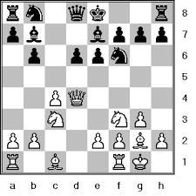
What are some *difficult* algorithms?
Chess AI Algorithm
Next best move
Positions on Chess Board

Slide 19
What are some *difficult* algorithms?
Que voulez-vous manger?
What do you want to eat?
Machine Translation Algorithm
French Text
English Text

Slide 20




What are some *difficult* algorithms?
Recommender System
User Watch History (a.k.a. log file)
Video Recommendations

Slide 21
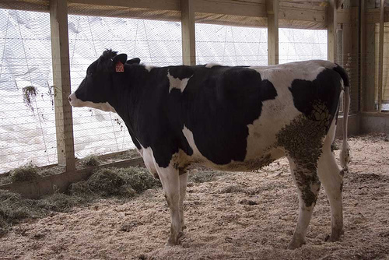
What are some *difficult* algorithms?
Image Object Detection Algorithm
Cow
Photo
Object in photo

Slide 22
What are some *difficult* algorithms?
Many More …
Speech Recognition (Siri, Google Now, Amazon Echo)
Medical Applications (Diagnosis, Imaging)
Knowledge (Google Search)
Face Recognition
…

Slide 23
Recall: Image Recognition
Pictures consist of a matrix of pixels (numbers). How can a computer guess the object from a matrix of numbers?
Image Object Detection Algorithm
Cow
Object in photo
Photo
Our goal is to avoid programming the complicated algorithm by-hand. We want to automatically create the algorithm.
We can use Machine Learning to do so!

Slide 24
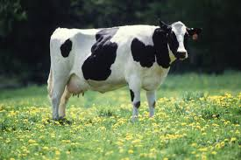

What is Machine Learning (ML)?
...
ML Algorithm
Cow
Flower
Training Data

Slide 25
What is Machine Learning (ML)?
...
ML Algorithm
Cow
Flower
Training Data
Image Object Detection Algorithm

Slide 26
What is Machine Learning (ML)?
...
ML Algorithm
Cow
Flower
Training Data
Image Object Detection Algorithm
Cow

Slide 27
What is Machine Learning (ML)?
ML Algorithm
Training Data
(x⁽¹⁾, y⁽¹⁾), … (x^{(n)}, y^{(n)})
x
Model
[parameters]
y
The model is a “mathematical transformation” from (x) to (y)
The ML Algorithm optimizes the parameters of transformation to maximize accuracy (or minimize error) on the training data.
ML models are tested on how well they can generalize to unseen examples

Slide 28
What is Machine Learning (ML)?
Your friend tells you: “I do Machine Learning at my job!”
If you are know about ML, then you would ask 4 questions:
What is your training data?
What is your model?
How do you train your model on the training data?
What is the “objective” function?
i.e. what do you maximize or minimize?
How do you optimize the objective function?
Also called “Parameter Estimation” or “Maximum Likelihood Estimation”

Slide 29
First ML Example: Regression on House Prices
Every house on the market is depicted as a blue circle.
x represents the area.
y represents the price.
If someone wants to sell their house? What price do you recommend?
Regression! Fit line y=mx + b
House Price
House Area

Slide 30
First ML Example: Regression on House Prices
Training Data
Houses (Areas + Prices)
Model:
Linear: y = mx + b
Objective Function:
House Price
Optimization Algorithm:
Newton’s method
Gradient Descent
More…
You can take it as a Black Box!
House Area

Slide 31
Homework 2: Recap
In Homework 2, you trained a perceptron. That is ML !
What is your training data?
Documents and their classes (truthful, deceptive, positive, negative)
What is your model?
Dot-product followed by sign() -- aka Perceptron
y_{truthful} = sign(b_{truthful} + dot(w_{truthful}, x))
y_{pos} = sign(b_{pos} + dot(w_{pos}, x))
How do you train your model on the training data?
Repeatedly Using Perceptron Update Rule.

Slide 32
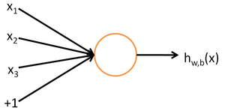
“Shallow Learning” versus “Deep Learning”:
Single Neuron (shallow):
[logistic regression, perceptron]
Issues:
Some terms might indicate multiple classes, depending on which other terms they co-appear with.
Consider spam email classification and the term “magnesium”.
“Magnesium” can appear in spam emails for “selling workout supplements” probably with the words “buy”, “purchase”, …
It can also appear in non-spam emails (e.g. scientific documents) perhaps with terms “electron”, “conductance”, “chemical”.
How do we allow terms to contribute to both classes?
One possibility: Deep Learning.
At best, this learns an importance of every term wrt class. Large Positive (/ negative) coefficient means term is strongly indicative of positive (/negative) class.

Slide 33
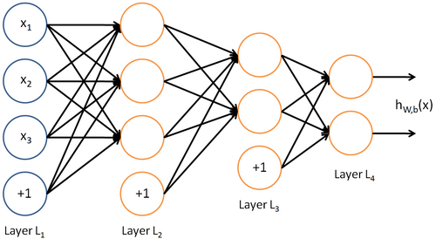
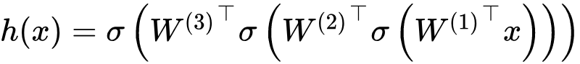
“Shallow Learning” versus “Deep Learning”:
Neural Network (deep):
Single Neuron (shallow):
[logistic regression, perceptron]
At best, this learns an importance of every term wrt class. Large Positive (/ negative) coefficient means term is strongly indicative of positive (/negative) class.
Simplest Deep Net:
Repeat the perceptron many times, from input to output
Goal: Find W, b at every layer

Slide 34
“Shallow Learning” versus “Deep Learning”:
Advantage
Some neuron in layer 2 might learn positive weights for “magnesium” and “buy”, and that neuron can be used to inform Spam Class.
Another neuron in layer 2 might learn positive weights for “magnesium” and “conductance” and that neuron can inform Non-spam class
aka: Automatic Feature Extraction
Neural Network (deep):

Slide 35
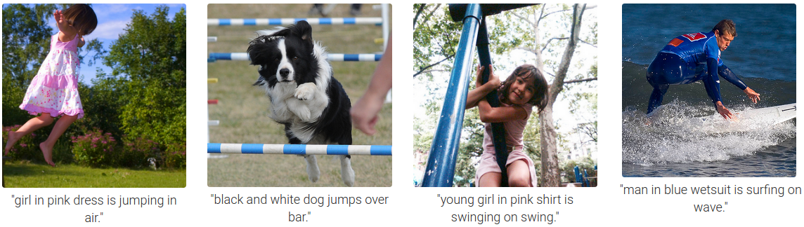
Computer Vision: Example Tasks
Image Classification*. Goal: Detect main object in photo.
Given a training set, train function f : image → object name
f(
) = “cow”
f(
) = “flower”
Image Captioning**. Goal: Describe a photo
Given a training set, train function f : image → English sentence
*Photos from http://image-net.org
**Screenshot from http://cs.stanford.edu/people/karpathy/deepimagesent/

Slide 36
Computer Vision: Image Classification
We would like to train a function that accepts an image and outputs object name.
Usually done by outputting a vector of real numbers. Size of output vector = size of vocabulary.
We designate each position in output vector to correspond to an item from the vocabulary.
We train the function to output high value (~1) for the correct class and ~0 to other classes.
cat
0.01
dog
0.01
0.01
cow
0.01
0.03
0.97
0.0
car
0.09
f(
) =
0.02
building
f(
) =
0.02
0.99
0.0
flower
…
…

Slide 37

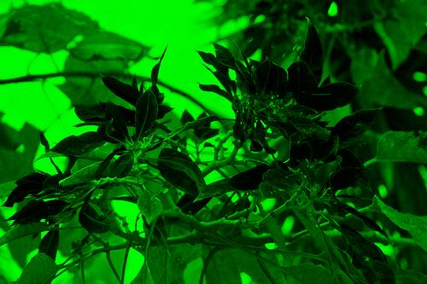

Computer Vision: Image Classification
cat
0.01
dog
0.01
cow
0.03
0.0
car
f(
) =
0.02
building
0.99
flower
…
f() can be a Deep Neural Network that consumes image as RGB.
f() usually consists of a few convolutional layers followed by a few fully-connected layers.
Convolution imples spatial invariance. First convolutional layer depicted:
(
)=
*
…
*
…
*

Slide 38
Computer Vision: Image Classification
f() can be pictorially expressed as:
0.01
W₁
W₂
W₃
W₄
0.01
0.03
x
x
0.0
*
*
0.02
flatten
0.99
…
…
…
The convolutional filters {W₁, W₂} and matrices {W₃, W₄} are the trainable parameters of f(); Trained to maximize accuracy (/ minimize error).
W₄ must have: # columns = size of vocabulary.
Last σ must output in range [0, 1], e.g. sigmoid: σ(z) = 1/(1+exp(-z))

Slide 39
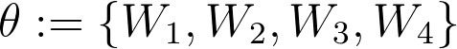
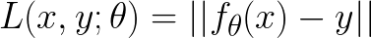
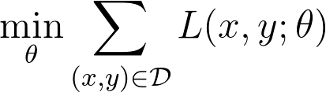
Computer Vision: Image Classification
The convolutional filters {W₁, W₂} and matrices {W₃, W₄} are the trainable parameters of f(); Trained to maximize accuracy (/ minimize error).
Notation
Error: … or ...
Minimize loss (e.g. via Stochastic Gradient Descent)

Slide 40
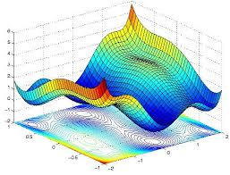
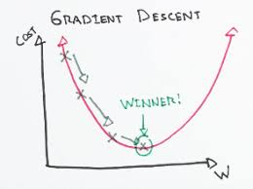
Gradient Descent
With one parameter:
With two parameters:
Modern Neural Networks have millions of parameters.

Slide 41
This seems hard :’(
I get the idea. I dont know how to proceed…
Do not worry! Welcome to 2019 …
You can do *all* the above in few lines of python code!
People have figured it out for you.
TensorFlow does the calculus for you. You only provide high-level instructions!
Sample code upcoming
Sometimes you can just use pre-trained models!

Slide 42
Ok fine. TensorFlow can do the hard work.
0.01
W₁
W₂
W₃
W₄
0.01
0.03
x
x
0.0
*
*
0.02
flatten
0.99
…
…
…
But, what’s happening in the W’s after training?
It is possible to visualize them!

Slide 43
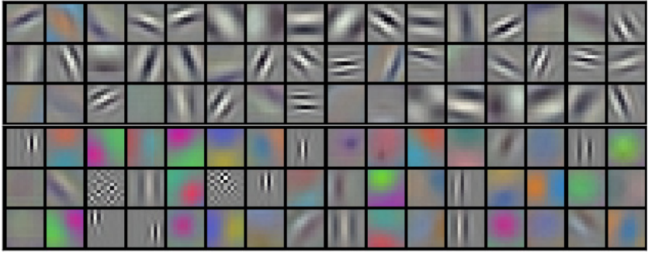
Computer Vision: Image Classification
What do the W’s learn?
First layer
[1] Alex Krizhevsky et al, “ImageNet Classification with Deep Convolutional Neural Networks”, NIPS 2012

Slide 44
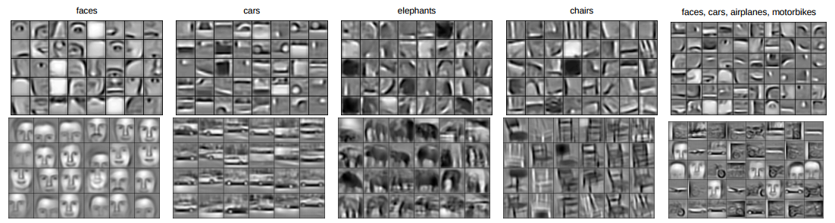
Computer Vision: Image Classification
What do the W’s learn?
Higher layers
[2] Honglak Lee et al, “Convolutional Deep Belief Networks for Scalable Unsupervised Learning of Hierarchical Representations”, ICML 2009

Slide 45
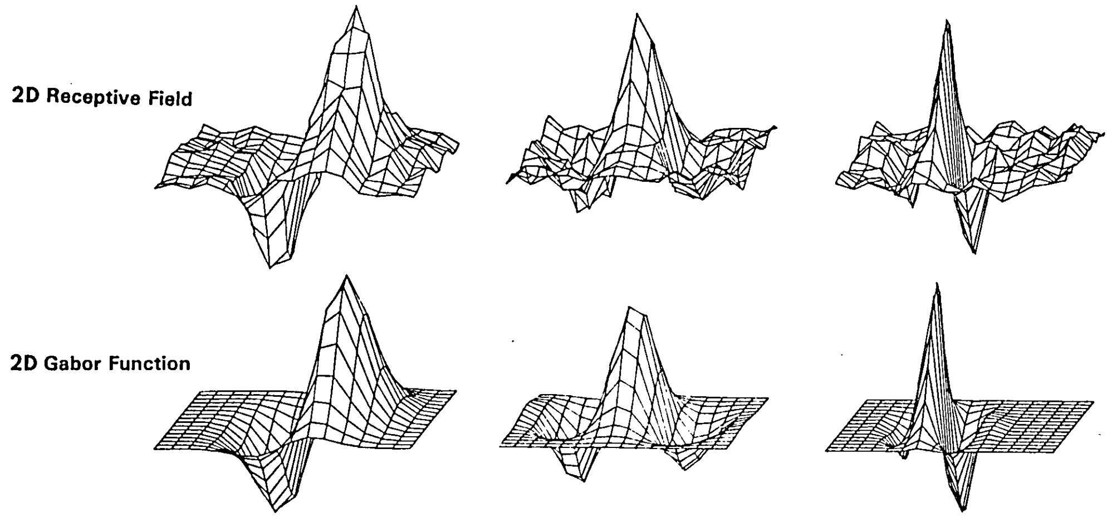
Links to Neuroscience
Do these look familiar?
Neuroscientists recognize it as Retina V1 in Visual Cortex.
Daugman, “Two-dimensional spectral analysis of cortical receptive field profiles”, Vision Research,1980
Daugman, “Uncertainty relation for resolution in space, spatial frequency, and orientation optimized by two-dimensional visual cortical filters”, Journal of the Optical Society of America, 1985 (paper link)

Slide 46
Agenda
What is Machine Learning
What is TensorFlow
TensorFlow Document Classification

Slide 47
What is TensorFlow?
Framework for doing math.
According to co-founder of OpenAI, Wojciech Zaremba, it is “the best abstraction for coding Machine Learning programs.”, where he mentioned it over friends dinner.
Included in your python as “import tensorflow as tf”
Interface is in Python
Python is used to define and invoke computations.
“Computation” is a Directed Acyclic Graph (DAG).
Execution is in C++ [can be on CPU or GPU]
As soon as you initialize a “tf.Session” variable in Python, a C++ backend will automatically get started for you, listen on some TCP port, and the python will connect to
There are a *ton* of TensorFlow add-on Frameworks, most popular:
Slim: Reduces lines of code by grouping common operations into single functions.
Keras: Makes Tensorflow look like sklearn (i.e. model.fit())
You can always mix-and-match Frameworks!
However, we will focus on barebones tensorflow. Can be verbose but useful e.g. to implement your own operations and/or optimization algorithms

Slide 48
What is a Tensor in TensorFlow?
Tensor: Node in the DAG.
Leaf nodes (i.e. without incoming edges) can be one of:
Placeholder (has no value, must be fed when evaluating DAG)
Variable (has a value, permanently stored in TensorFlow’s memory [on CPU or GPU])
Dataset Readers (Creates a Reader Buffer)
Not covered in this talk. A good tutorial is on: https://www.tensorflow.org/api_guides/python/reading_data
Intermediate nodes (with incoming edges) are Expressions of Tensors
Tensor is a class that over overloads all math operators:
+, -, *, /
(The above default to element-wise)

Slide 49
Your First Tensorflow Program!
import tensorflow as tf a = tf.placeholder(tf.float32, []) b = tf.placeholder(tf.float32, []) y = a * b sess = tf.Session() # Starts C++ Backend sess.run(y, {a:2.5, b:3.0})
y
*
a
b
Feed dictionary. Must satisfy all DAG inputs for requested outputs.
You can run (i.e. evaluate) any node on the DAG.
You can also evaluate a list of nodes, in which case, run returns a list of same size as first argument. You can also run dicts.
It is also possible to run operations (a.k.a. ops, next)

Slide 50
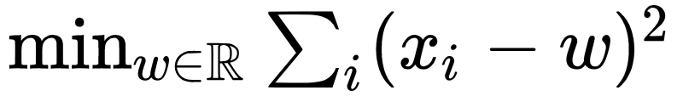
Toy Optimization
We show a very basic problem:
using barebones TensorFlow.
Code is on next slide

Slide 51
import tensorflow as tf x_list = tf.placeholder(tf.float32, [None], name='x') w = tf.Variable(0.0, name='w') error = (w - x_list) ** 2 # Note broadcasting. error is a vector (not scalar). grads = tf.gradients(error, [w]) # derivative of error w.r.t. scalar is a scalar. Sum implied gw = grads[0] learn_rate = 0.05 assign_op = w.assign(w - gw * learn_rate) sess = tf.Session() sess.run(tf.global_variables_initializer()) for i in xrange(100): sess.run(assign_op, {x_list: [1,2,3,4,5]}) # Mean should be 3.0 print 'Converged to %f' % sess.run(w)

Slide 52
Primitives
Tensor: Node in the DAG.
Leaf nodes (i.e. without incoming edges) can be “Placeholders”, “Dataset Readers”, or “Variables”
Intermediate nodes (with incoming edges) are Expressions of Tensors.
Gradients
E.g. grads = tf.gradients(y, [a])[0]
Assign Operators.
Applicable to Variables but not Placeholders
Collections
While constructing Model, most functions automatically adds Tensors to collections. Model Optimization retrieves Tensors from collections.
tf.global_variables()
tf.trainable_variables() # By default, all variables are made “trainable”
tf.losses.get_regularization_losses()
tf.losses.get_losses()
Summary Operators [Allows on TensorBoard, not in this talk, but on here].
Save and Restore Operators [Not on this talk, but here]
We will use Pickle to save and restore. [Recall, we focus on barebones TensorFlow]

Slide 53
Useful Features & Tricks
Make is_training to be a Boolean Tensor.
During training steps: feed as True. During measuring accuracy on validation: feed as False.
In the former, it will do BatchNorm and Dropout. In the latter, it uses BatchNorm statistics and no Dropout.
Layers.
fully-connected layer takes as input matrix of activations ℝ^{b x d0}, multiplies by (trainable variable) kernel matrix ℝ^{d0 x d1}, adds (trainable variable) bias vector ℝ^{d1}, passes through Batchnorm, then through element-wise nonlinearity. Also, add L2 regularization penalty on the kernel matrix.
The Kernel Matrix should not be initialized to all zero (like our toy example). Instead,
You can do each of the above as a separate line (using “pure barebones”), or can do all in one-line using tf.contrib.layers.fully_connected
Saving and Restoring Variables
I personally use Pickle!

Slide 54
MNIST Example (Using Keras)
I will only flash it for reference, as I prefer to use Barebones Tensorflow
Code is on next slide (borrowed from link)

Slide 55
import tensorflow as tf mnist = tf.keras.datasets.mnist (x_train, y_train),(x_test, y_test) = mnist.load_data() x_train, x_test = x_train / 255.0, x_test / 255.0 model = tf.keras.models.Sequential([ tf.keras.layers.Flatten(input_shape=(28, 28)), tf.keras.layers.Dense(512, activation=tf.nn.relu), tf.keras.layers.Dropout(0.2), tf.keras.layers.Dense(10, activation=tf.nn.softmax) ]) model.compile(optimizer='adam', loss='sparse_categorical_crossentropy', metrics=['accuracy']) model.fit(x_train, y_train, epochs=5) model.evaluate(x_test, y_test)

Slide 56
Agenda
What is Machine Learning
What is TensorFlow
TensorFlow Document Classification

Slide 57
Document Classification (Using Barebones TensorFlow)
We will show TensorFlow code (on: http://sami.haija.org/cs544/DL1/code.py)
General gist.
Given (X) and (Y): First is a matrix of input features (# docs x features) and second is target matrix (# of docs x number of classes)
Start with input matrix (X)
Apply a series of transformations to the matrix.
The last transformation produces h(X)
Add a loss term that encourages h(X) to be as similar as possible to matrix (Y)

Slide 58
Saving Model
You can save the parameters like:
import pickle var_dict = {v.name: v for v in tf.global_variables()} pickle.dump(sess.run(var_dict), open('trained_vars.pkl', 'w'))
And restore like:
import pickle var_values = pickle.load(open('trained_vars.pkl')) assign_ops = [v.assign(var_values[v.name]) for v in tf.global_variables()] sess.run(assign_ops)

Slide 59
Next Deep Learning Classes
More powerful Machine Learning Models for NLP tasks (Machine Translation, Neural Word Models).
TensorFlow code.
Flash Neural Machine Translation Github: https://github.com/tensorflow/nmt

Slide 60
Thank you for attending!
Any questions?

Slide 61
Advanced Features
Alternating Minimization [demonstrate live]
In some cases, you might be interested in partitioning the model parameters into subsets: update each subset together while holding other parameters fixed.
We did it at Google (e.g. attention network over videos, we update the attention parameters only when presenting with short videos and/or clean videos).
tf.stop_gradient() is useful for not propagating gradients backwards
tf.custom_gradient() is useful for implementing backprop through discrete output functions
Meta-Learning [Talk about]

